Slide 1
Decision Support for
National Development Strategies and Policy Dialog
in the
CAREC Region
David Roland-Holst, UC Berkeley
Central Asia’s Economic Opportunities:
Economic Corridors and Global Value Chains
Inaugural Knowledge Sharing Workshop of the CAREC Institute
Urumqi, People’s Republic of China, 2–3 March 2015
dwrh@berkeley.edu

Slide 2
Overview
Regional economic integration is accelerating in Central Asia, significantly because of determined national and international commitments to infrastructure and other investments.
This has been complemented by substantial progress on the institutional side, promoting a more open multilateral trade and investment environment.
In a rapidly evolving regional economy, however, decision makers need support for more evidence-based strategic planning and engagement.
This project develops a new generation of decision tools for economic assessment and policy dialog, nationally, regionally, and with international development partners.

Slide 3
Information Sharing
At our last ADB meeting on this subject, an expert group proposed a four-part information services strategy:
Host an online data portal covering trade, infrastructure, and related economic activity.
Develop indicators related to trade, corridors, and infrastructure generally.
Develop decision tools that make effective use of the first two resources.
Disseminate these data, indicators, and decision tools across the regional policy community, with emphasis on capacity building.

Slide 4
Monitoring: Indicators and Metrics
System performance - how effective are regional commitments/investments?
Public Agency: Metrics and indicators
Trade Facilitation
Infrastructure and logistics performance
Private Agency: Investment climate, standards and indicators

Slide 5
Impact Evaluation
How are economic activities and livelihoods changed by regional integration?
Need to capture heterogeneity and net benefits across diverse stakeholder groups
Beyond macro aggregates - Explicitly spatial and more detailed
Beyond point estimates - Need to recognize and estimate the role of risk and uncertainty

Slide 6
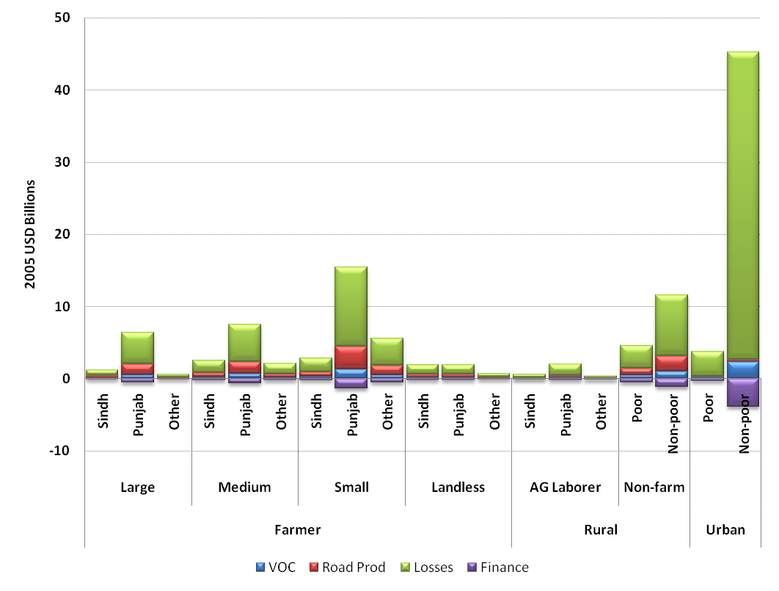
Example 1: Pakistan Northern Corridor Household Total Real Income Growth Cumulative Over Baseline, 2006-2030
Punjab has more transport-intensive agricultural products.
For the Urban Non-poor, income and expenditure effects combine to confer transport benefits.

Slide 7
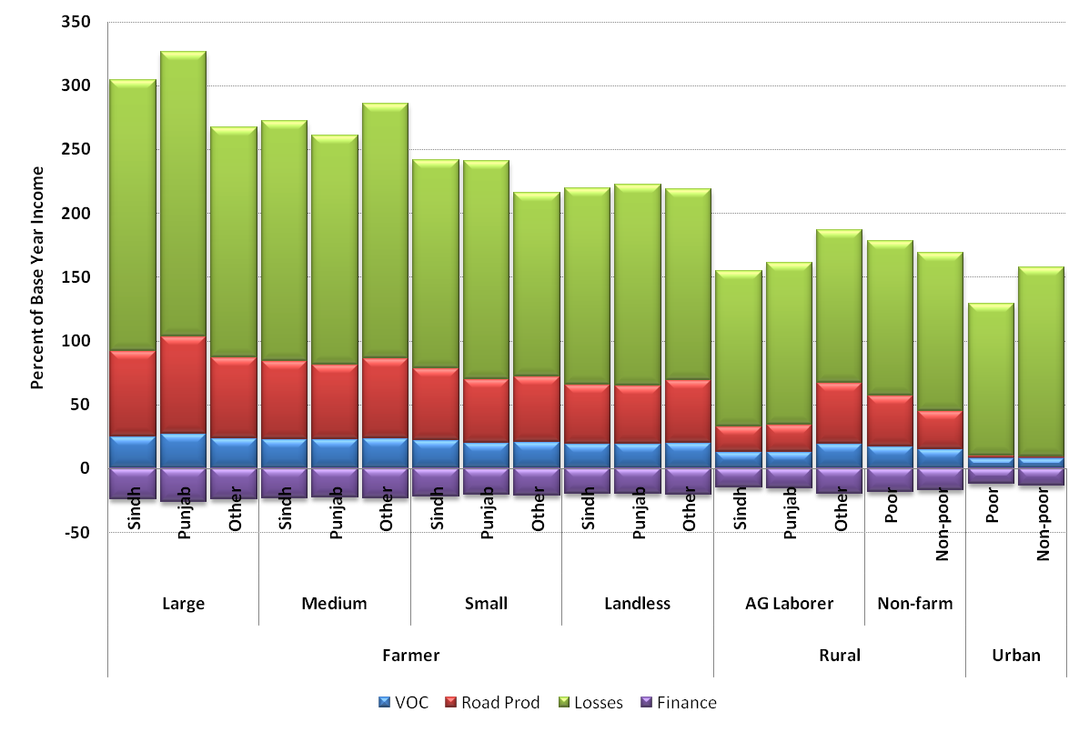
Household Income Growth as a Percentof 2006 Income
The project is generally pro-poor, with small and landless rural farm households gaining more than Non-poor Non-farm and Urbanites.

Slide 8
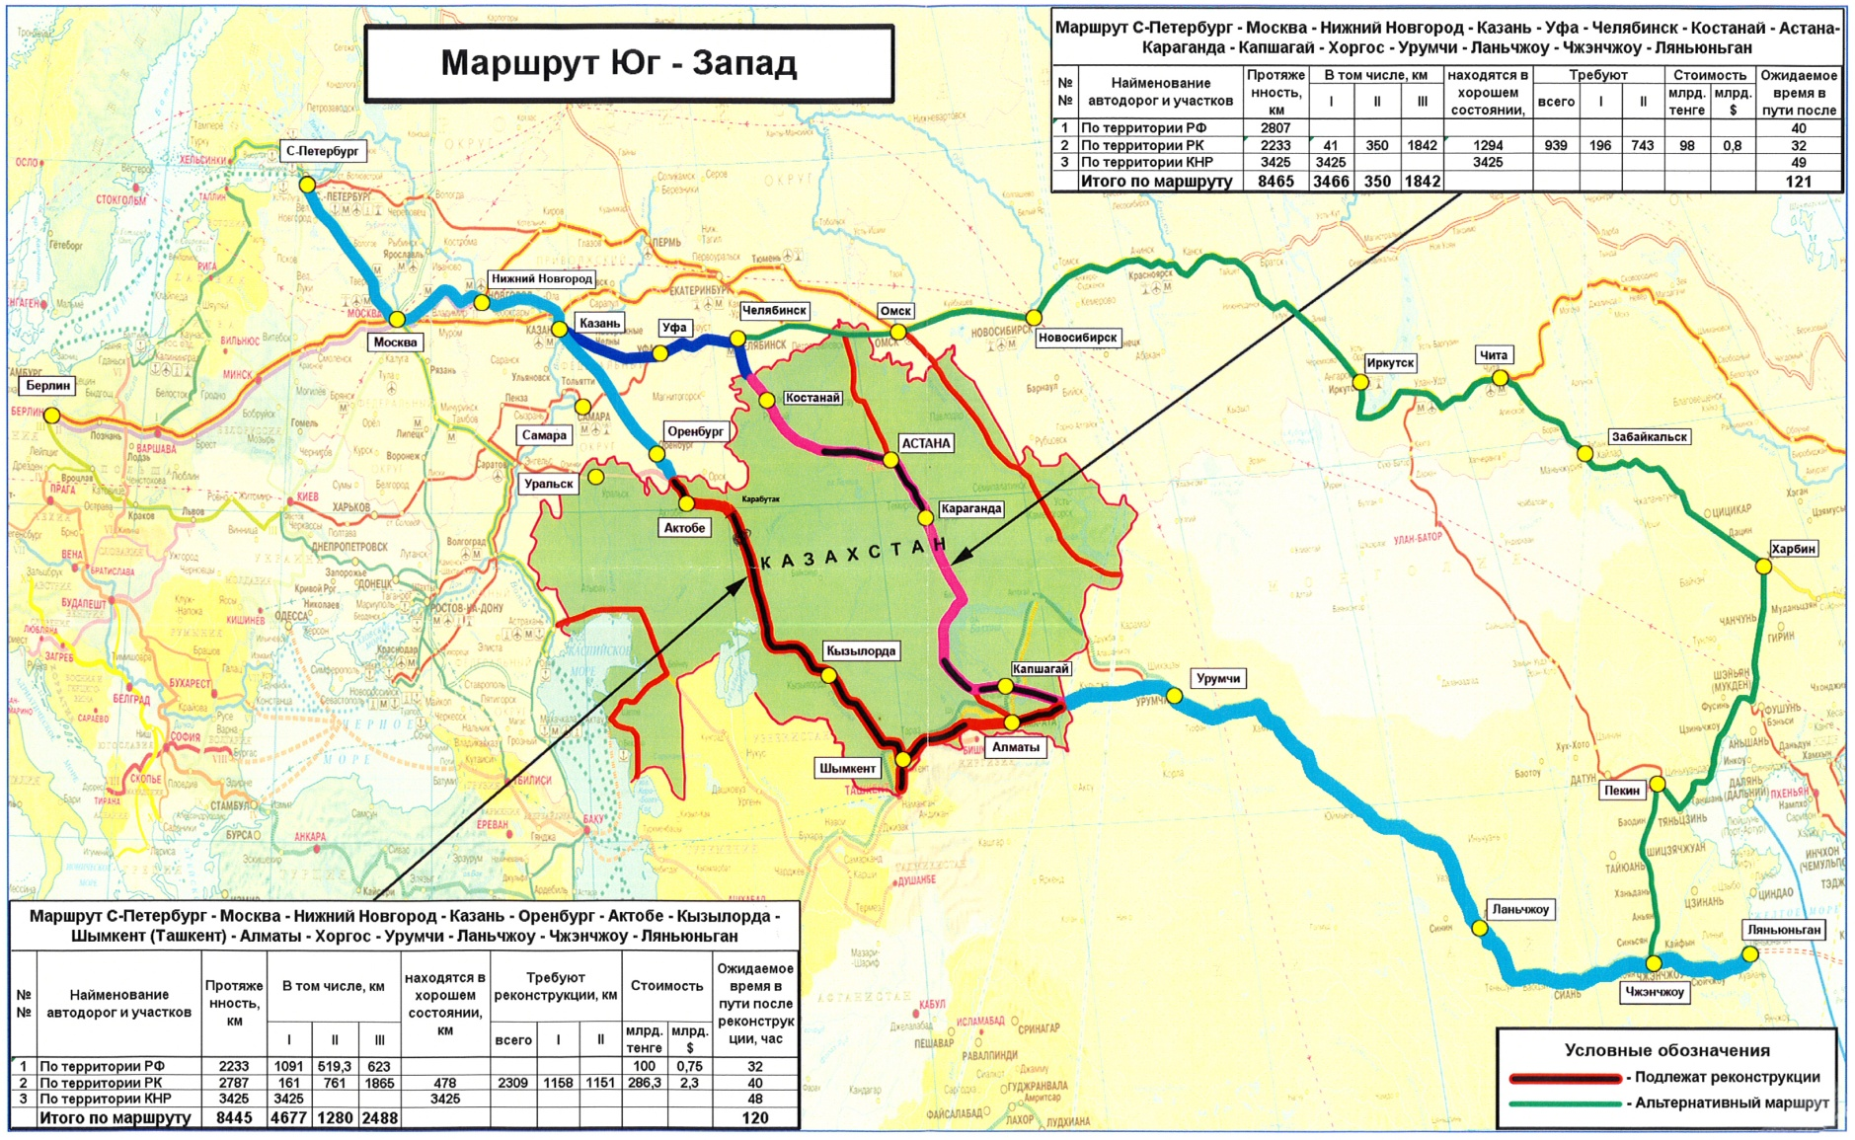
Example 2: Kazakhstan Corridor

Slide 9
Real GDP Growth (Percent of 2010, annual with respect to Baseline)
The main beneficiaries in relative growth terms are Kazakhstan and proximate economies.
Regional spillovers are quite significant.

Slide 10
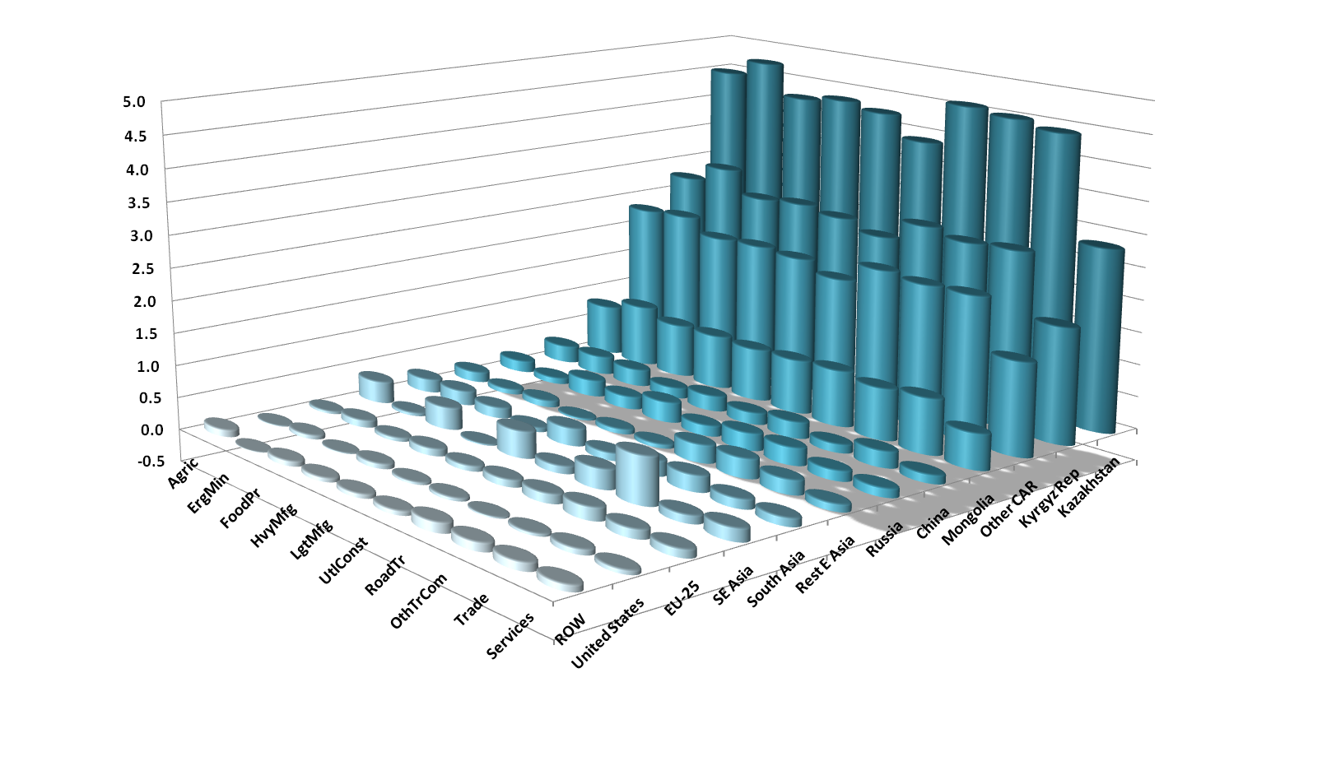
Sectoral Output Growth (Multiple of Baseline in 2030)
Sectoral benefits are relativey uniform for local economies, more varied for trading partners.

Slide 11
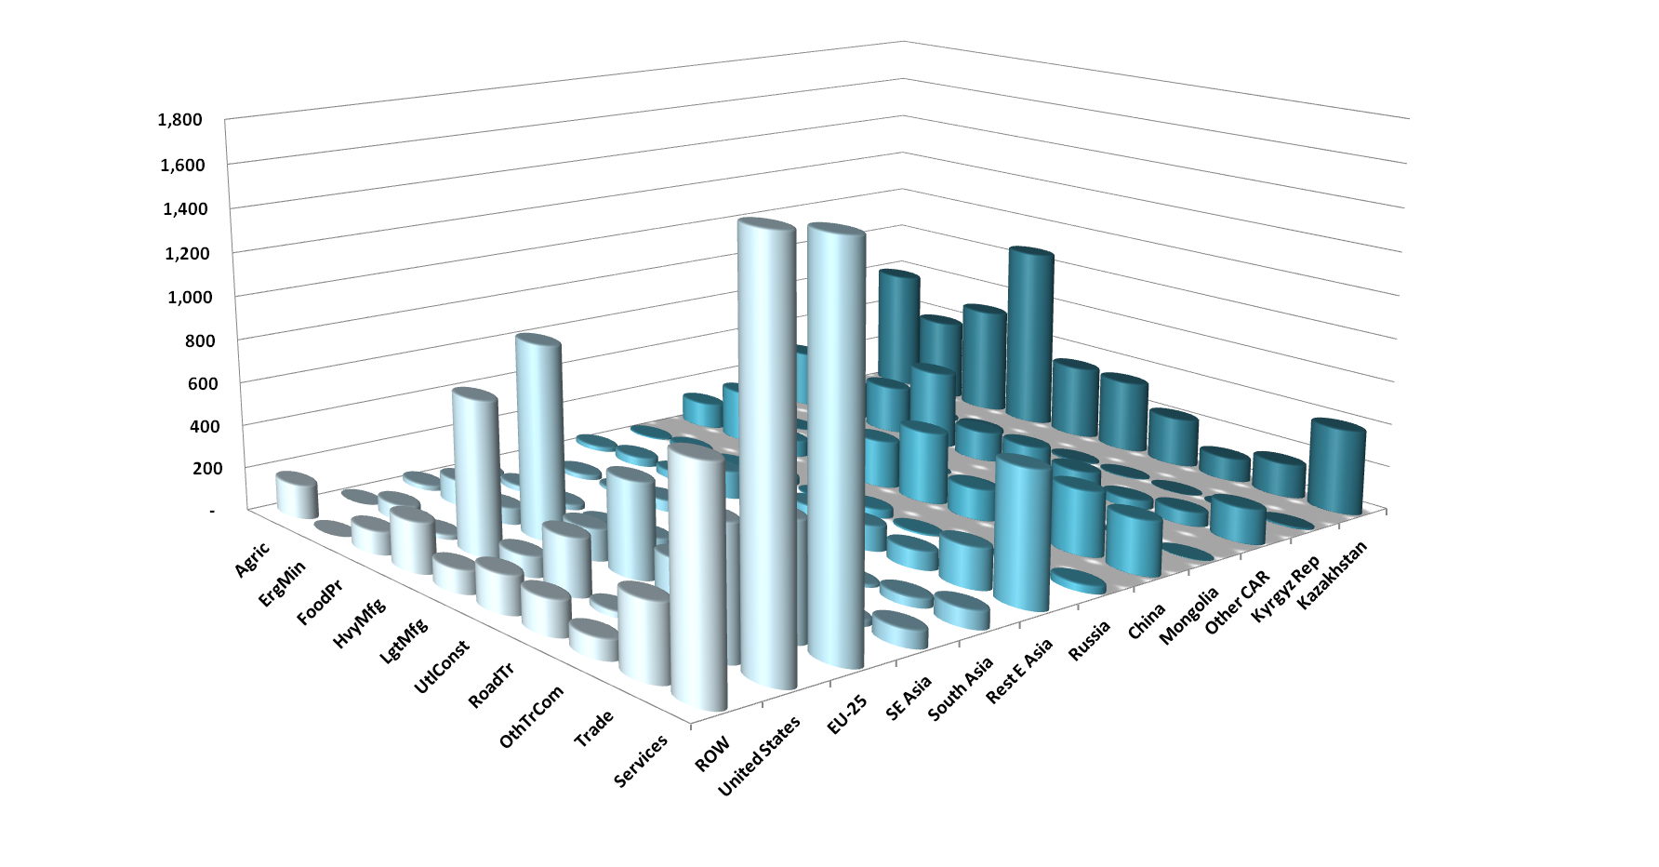
Sectoral Output Growth (USD 2010 Millions wrt Baseline in 2030)
Nominal gains are much more varied, depending on initial scale and trade shares.

Slide 12
How evidence-based forecasting can help policy
Ex ante perspective: look before you leap
Identify/quantify real impacts: - how much and for whom?
Reduced costs (TTT, VOC, time, etc.)
Expanded investment horizons
Larger markets
Transport vs. Development – capture integrated, indirect, and longer term impacts
Second-generation infrastructure – find the next level
Adjustment assistance
Identify adjustment needs before they lead to problems
Support dialog
Public: local, national, regional coherence/coordination
Private: arouse private stakeholders to complete the Commitment Game

Slide 13
CARGO: Central Asian Policy Simulation Model
The basic architecture of this regional modeling facility is based on a global prototype designed at the University of California, Berkeley.
This combines a multi-country Computable General Equilibrium (CGE) forecasting model with an interactive, user-friendly, browser-based “dashboard” for decision makers.
These tools are designed to be implemented on local computers/tablets with a browser interface.

Slide 14
Basic CARGO Ingredients
Like all good economic policy, CARGO stands on two legs, highest quality data and analytical methods:
Data: A country-by-country, integrated database for assessing economic linkages, policy and market outcomes, energy flows, and environmental impacts
Calibrated to GTAP-8, plus estimated Social Accounting Matrices for other CAREC economies
Up to 57 sectors/commodities
Annual projections to 2050
Model: A state-of-the-art, economic scenario forecasting tool – downscaled from a global CGE developed at UC Berkeley

Slide 15
Regional Modeling Capacity
A new CAREC regional model has been developed as part of TA-8259, Assisting The Central Asia Regional Economic Cooperation Institute Knowledge Program
The most advanced, up-to-date, and detailed model of its kind.
The current version has 19 countries/regions, up to 57 sectors
Could be decomposed into individual member country models (e.g. TA-8259, Phase II)
Results communication takes two forms:
Traditional technical reporting
A user-friendly data/results browsing app for dissemination to decision makers

Slide 16
Central Asian Regional General equilibrium mOdel (CARGO)

Slide 17
How we Forecast
Global GE Model
Transport
The CARGO model has been developed in four components:
1. Core Economic model
Emissions
Energy
2. Transport module
3. Energy production/distribution
4. Emissions module

Slide 18
Detailed CARGO Framework
National and International Initial Conditions, Trends, and External Shocks
Use Data
Engineering Estimates
Infrastructure Data
Global GE Model
Prices
Demand
Sectoral Outputs
Resource Use
Transport
Trade promotion
Financial and labor reform
Industrial Policies
Investment
TT Policies
Innovation:
Production
Consumer Demand
Detailed Emissions
of C02 and non-C02
Emissions
Detailed State Output,
Trade, Employment,
Income, Consumption,
Govt. Balance Sheets
Energy
Efficiency incentives
Emissions standards
Energy Regulation
Oil Market
Detailed Emission
Database
IEA Energy Balances
Elect Generation Data
Engineering Estimates
- Data
- Results
- Policy Intervention

Slide 19


CARGO System Architecture
National Models
Regional Model
Graphic User Interface
Afghanistan
.…
CAREC
Xinjiang
ADB
National Capitals
Policy Makers

Slide 20


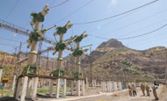
Sample Model Inputs: CAREC Modeling Scenarios
Transport and Infrastructure Policies
Regional corridor schemes for national, regional, and global perspectives
Regional implications of national investments
Motorization and urbanization
Trade Facilitation and Trade Policies
Asian regional integration – national, regional, and global implications
Bilateral and regional TT measures
Integrated Trade Facilitation
Energy Policies
Strategy for Regional Cooperation in the Energy Sector
Energy Action Plan Framework
Regional energy security

Slide 21
Sample Model Outputs: What we forecast
Category | Variables
Economic Structure | Sectoral output, demand, imports, and exports for each country.
Income | Total and per capita GDP by region Value added and employment by sector and country Household income by household category
Employment | Total employment by sector and country Employment rates by household category
Energy | Total energy use by sector and country Energy trade, production and usage mix by country Energy use by household type
Emissions | GHG emissions (CO₂, CH₄, N₂O) by source, use, and region

Slide 22
Extensions
Regional assessment of trade and investment potential.
Transport pathways: Detailed regional impact evaluation.
Energy pathways: Detailed regional impact evaluation.
Dynamics of regional growth and poverty reduction.
Policy impacts on development indicators, MDG’s, etc.
Trends in urbanization and rural development.
Resource development, public investment, and fiscal impacts.
Demographic assessment, including migration, labor force development and employment patterns, and other socioeconomic trends.
More detailed agent-based GIS modeling to improve policy targeting and impact evaluation.

Slide 23
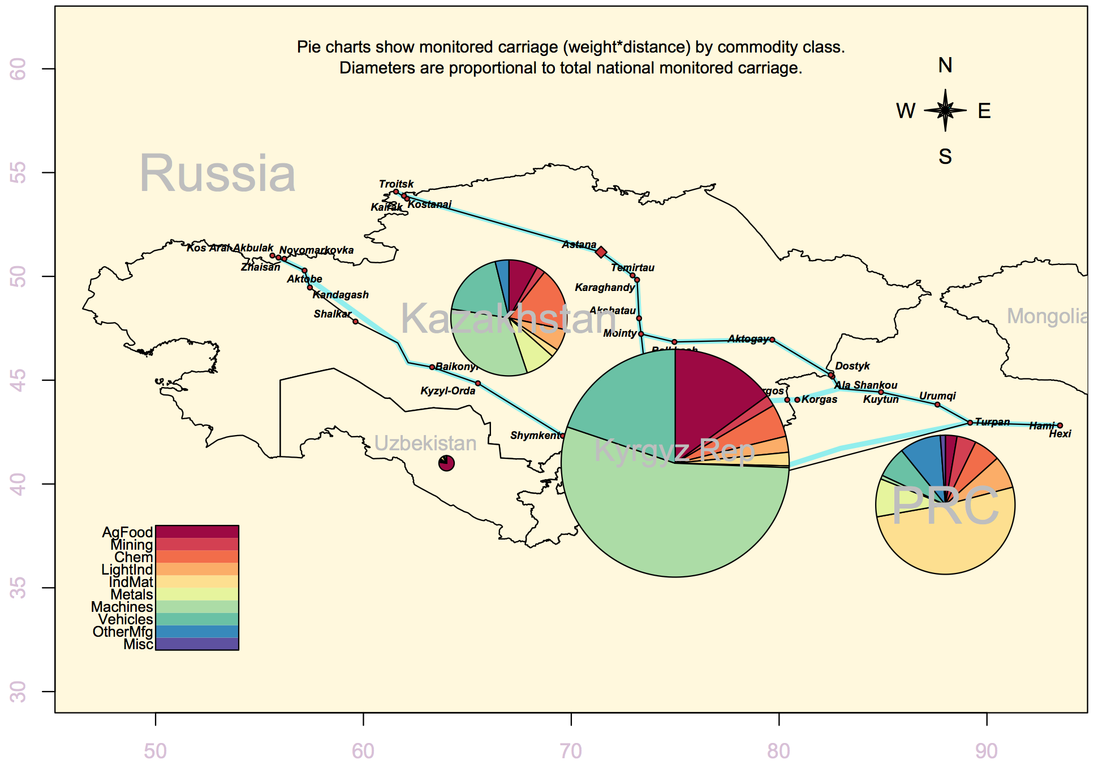
Sample CARGO Map 1: CAREC Corridor Shipments by Country and Commodity

Slide 24
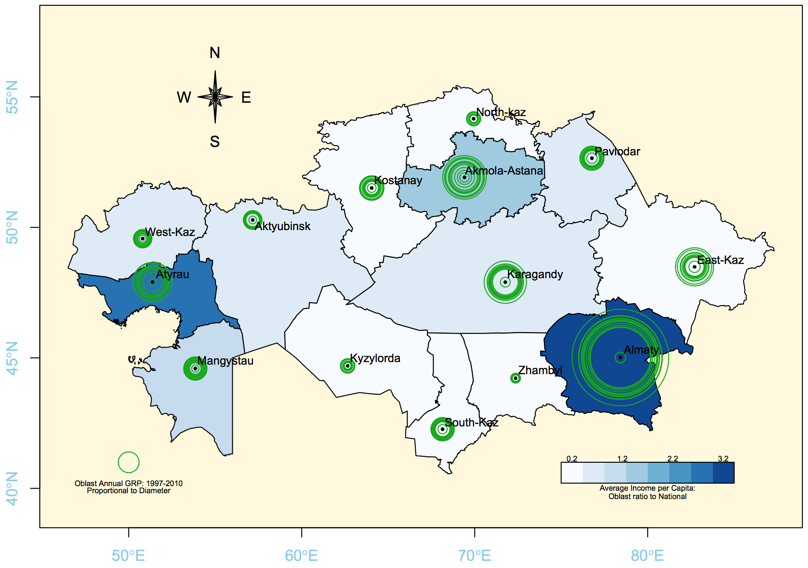
Sample CARGO Map 2: Kazakhstan - Oblast GRP and Income per Capita

Slide 25
The Policy Dashboard
CARGO represents a new generation of policy simulation models, combining
Detailed structural data
State-of-the-art forecasting model
The Policy Dashboard is a user-friendly, graphic interface that allows visualization of policy impacts.

Slide 26
Demonstration
Now we switch to a browser.

Slide 27
Thank you

